Slide 1
Choosing the Perfect Neighborhood
By Ella Brucker

Slide 2

Introduction
I have been faced with the hard question of “What next?”. Planning on beginning a career in data science and moving to a new location, I now must narrow down which areas in the new location will be the best for me to move to.
Venue categories will be found to help determine if the areas suit my interests and has a wide variety of places nearby.
Then neighborhoods matching my interests can be narrowed down and the most popular venues of each location found.
This will help narrow down which places are most frequented in each neighborhood, and in turn, help someone decide if that neighborhood is somewhere, they would want to live.

Slide 3
Problem
It seems common that young professionals and new graduates are in a similar position as me – wanting to move somewhere new when beginning a career, but not being familiar with the area and not knowing where to live.
Having a way to find out what spots are available in a certain location – even if you are not familiar with it - would be extremely helpful for everyone in this position.
As similar as this project is to the one from week three, it is relevant to several peers and I, contemplating moving to Toronto this coming summer – but unable to visit due to the current pandemic.

Slide 4

Data
The first step in cleaning the data was to remove cells with boroughs that were not assigned, and then to assign neighborhoods with unassigned boroughs to the same borough.
Postal codes with more than one neighborhood, they were assigned to the same row.
No columns needed to be dropped or added to the table.
Source of the data will be from a Wikipedia website.
Wikipedia will be the least complicated to scrap data from.
The dataframe will be divided into the columns of postal code, borough, and neighborhood.

Slide 5
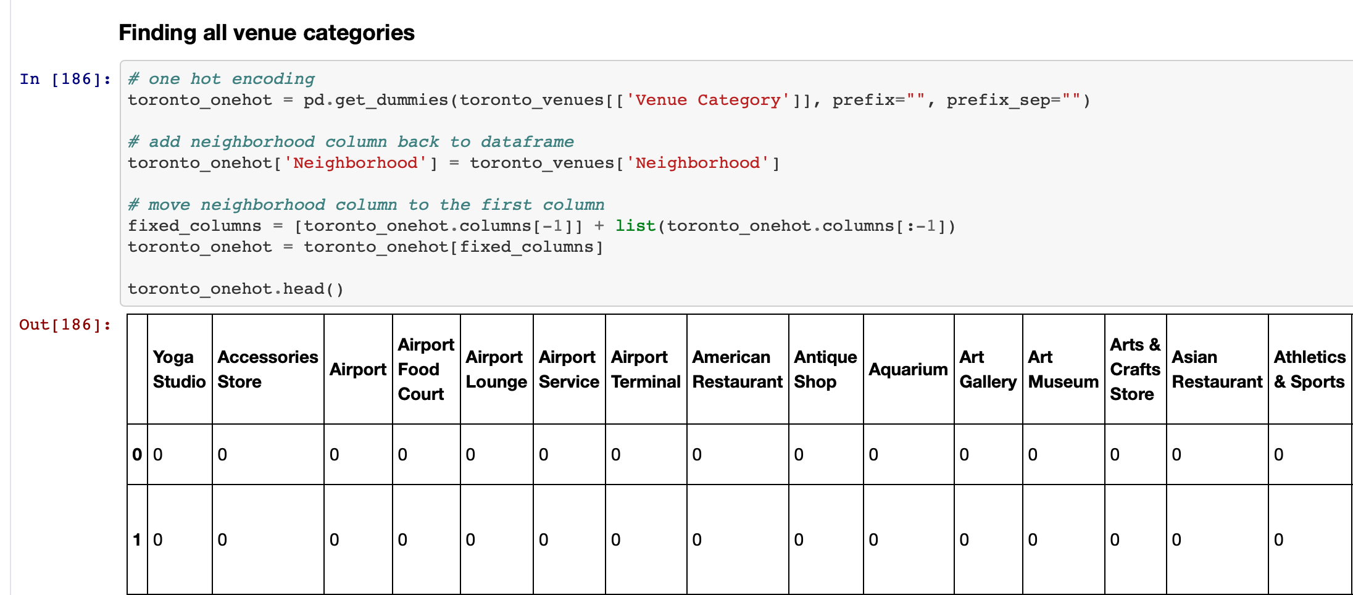
Methodology
Exploratory Data Analysis
And
Inferential statistics and machine learning
Determined which venues could be found in each neighborhood with Foursquare location data
This will narrow down which areas I want to live in by seeing which areas have venues related to my interests.
Dataframe was manipulated to show different types of venues available across the different areas and how many are in each neighborhood.
Next, I found the top 10 locations in each neighborhood, further enabling me the be able to narrow down which neighborhoods would not meet my interests based on which venues were most popular in the area.

Slide 6
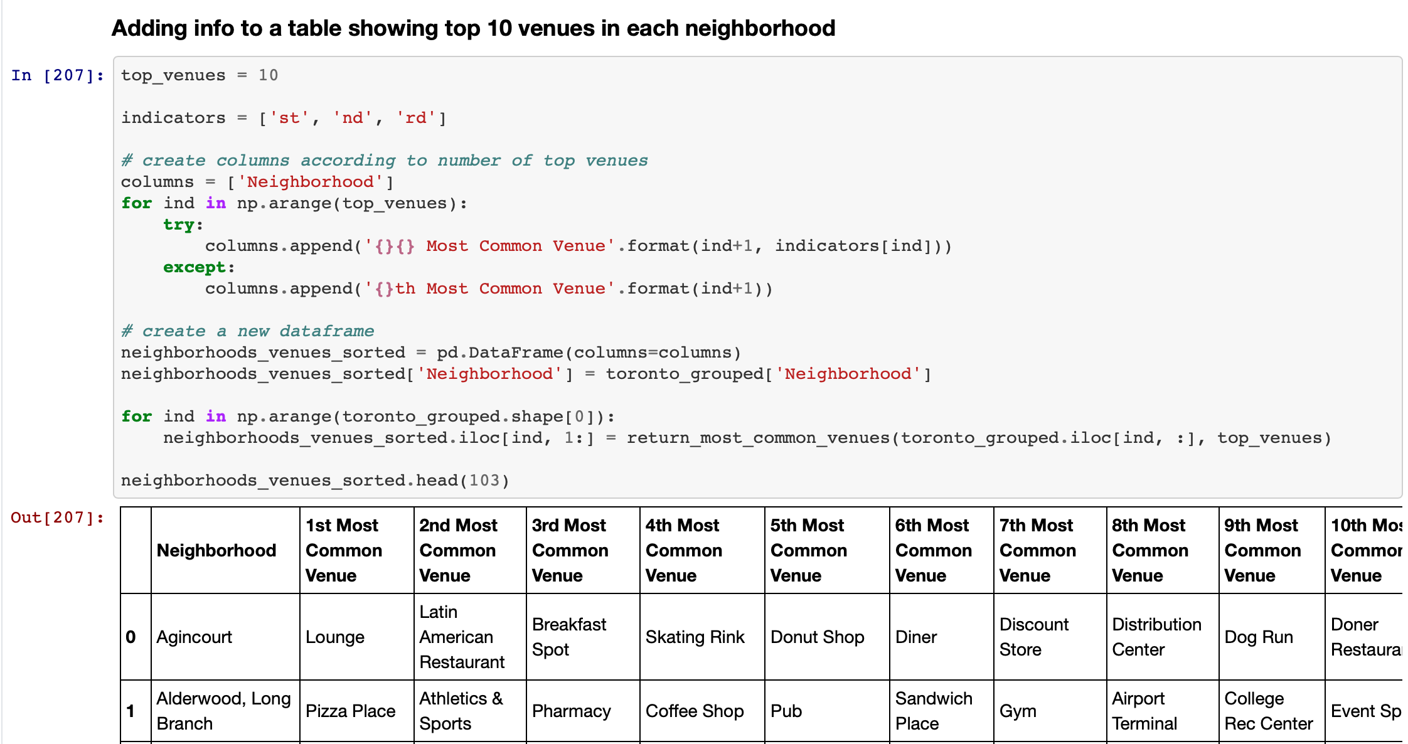
Results
Results showed which neighborhoods contained venues of interest and were places I could consider myself living in.
A few of op Picks were
Berczy Park,
Central Bay Street,
Christie,
Don Mills,
Little Portugal,
Lawrence Park,
Studio District,
Regent Park.
Personal interest in these areas based on food cuisine choices, coffee shops, gyms, and athletic related activities available.

Slide 7
Discussion
Observations
Recommendations
Toronto has a very diverse group of neighborhood venues ranging from gay bars to dog runs.
Each neighborhood had many more venues than the amount the neighborhoods in my current city contain.
While some neighborhoods contained a very specific type of venue, like restaurants or retail, overall – most of the venues has at least a coffee shop, restaurants, and store.
My current city has several large areas, not just neighborhoods, that contain most of the restaurants or nightlife, but I like the idea of each neighborhood containing its own little “city”.
If I were to do this type of analysis again, I would try to also add cost of housing in each neighborhood or borough to the dataframe.
This is an equally important information, on top of an area containing venues of your interest, needed to determine which area would be the most suitable for one’s preferences and needs.

Slide 8
Conclusion
Again, while this project used the same location data from a previous assignment, it is relevant to a current issue I am facing – as well as several other young professionals I am acquainted with.
Using location data to be able to explore/analyze places of interest, especially when you are unfamiliar with or unable to visit the places in person, is very helpful for anything trying to decide where to move to or even when trying to figure out which area to start a business in.
This project concludes the IBM Data Science Professional Certificate and is just a glimpse of all of the skills learned and developed through the previous 9 courses taken.

